Slide 1
Project Scope Management
Source: Jack T. Marchewka, Northern Illinois University

Slide 2
Learning Objectives
Identify the five processes that support project scope management. These processes, defined by PMBOK®, include initiation, planning, scope definition, scope verification and scope change control.
Describe the difference between product scope and project scope.
Apply several tools and techniques for defining and managing the project’s scope.

Slide 3
Scope
Definition:
Project scope refers to the deliverables or work products that must be completed in order to achieve the project’s MOV.
Provides a boundary so that what needs to get done – gets done.
  Otherwise, schedule and budget are increased for no reason
Defines what is part of the project team’s work and what is not.
  This also sets expectations for all of the project’s stakeholders
Provides a link between the project’s MOV and the project plan.

Slide 4
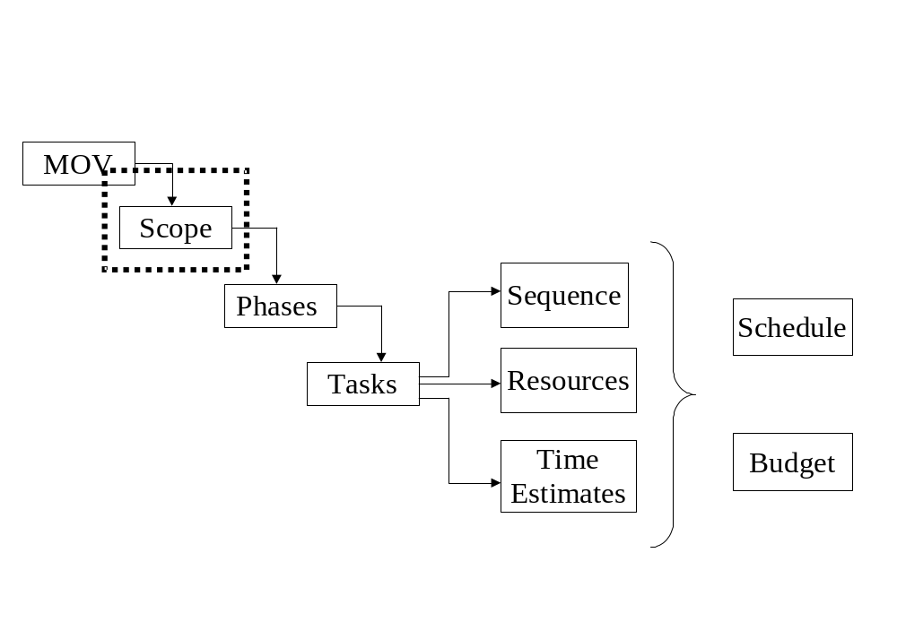
Project Planning Framework

Slide 5
PMBOK Scope Management Processes
Scope Management Process | Description
Scope Planning | The development of a scope management plan that defines the project’s scope and how it will be verified and controlled throughout the project.
Scope Definition | A detailed scope statement that defines what work will and will not be part of the project and will serve as a basis for all future project decisions
Create Work Breakdown Structure (WBS) | The decomposition or dividing of the major project deliverables into smaller and more manageable components.
Scope Verification | Confirmation and formal acceptance that the project’s scope is accurate, complete, and supports the project’s MOV.
Scope Change Control | Ensuring that controls are in place to manage proposed scope changes once the project’s scope is set. These procedures must be communicated to all project stakeholders.

Slide 6
Project Scope Initiation & Planning
A beginning process that formally authorizes the project manager and team to develop the scope management plan
This entails
  Conceptualizing the Scope Boundary
  Developing the Scope Statement

Slide 7
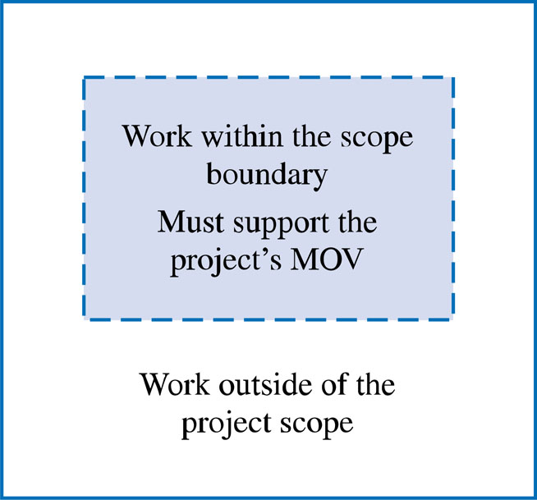
The Scope Boundary
“Failure to define what is part of the project, as well as what is not, may result in work being performed that was unnecessary to create the product of the project and thus lead to both schedule and budget overruns.”
- Olde Curmudgeon, 1994
(an anonymously written column in PM Network Magazine)

Slide 8
The Scope Statement
Provides a way to define the scope boundary.
A narrative of what deliverables or work-products the project team will and will not provide throughout the project.
A first step that provides a high-level abstraction of the project’s scope that will be defined in greater detail as the project progresses.

Slide 9
Scope Statement : Example 1 (Work within the scope boundary)
Develop a proactive electronic commerce strategy that identifies the processes, products and services to be delivered through the World Wide Web.
Develop an application system that supports all of the processes, products and services identified in the electronic commerce strategy.
The application system must integrate with the bank’s existing enterprise resource planning system.

Slide 10
Project Scope Definition
Project-Oriented Scope
  Deliverables that support the project management and IT development processes defined in the Information Technology Project Methodology (ITPM).
  Examples
    Business case, project charter and project plan, etc.
Product-Oriented Scope
  High-level features and functionality of the application system
  First cut for requirements definition that will be defined in greater detail during the systems development life cycle (SDLC)
  Examples
    Add new customer, look up customer balance, print daily sales report by region, etc.

Slide 11
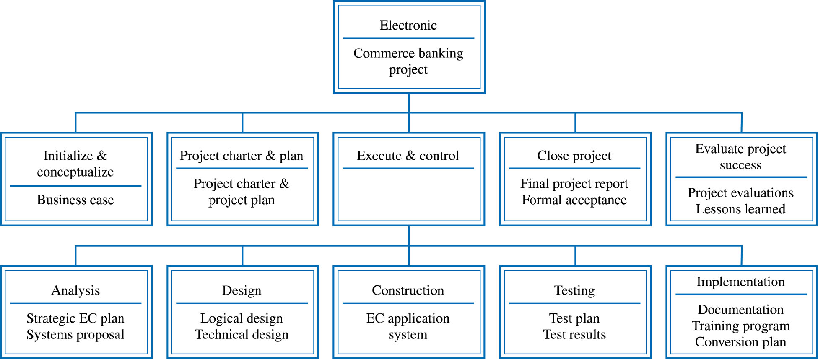
Deliverable Structure Chart

Slide 12
Product-Oriented Scope Definition Tools
Context Dataflow Diagram (DFD)
Use Case Diagram (USD)

Slide 13
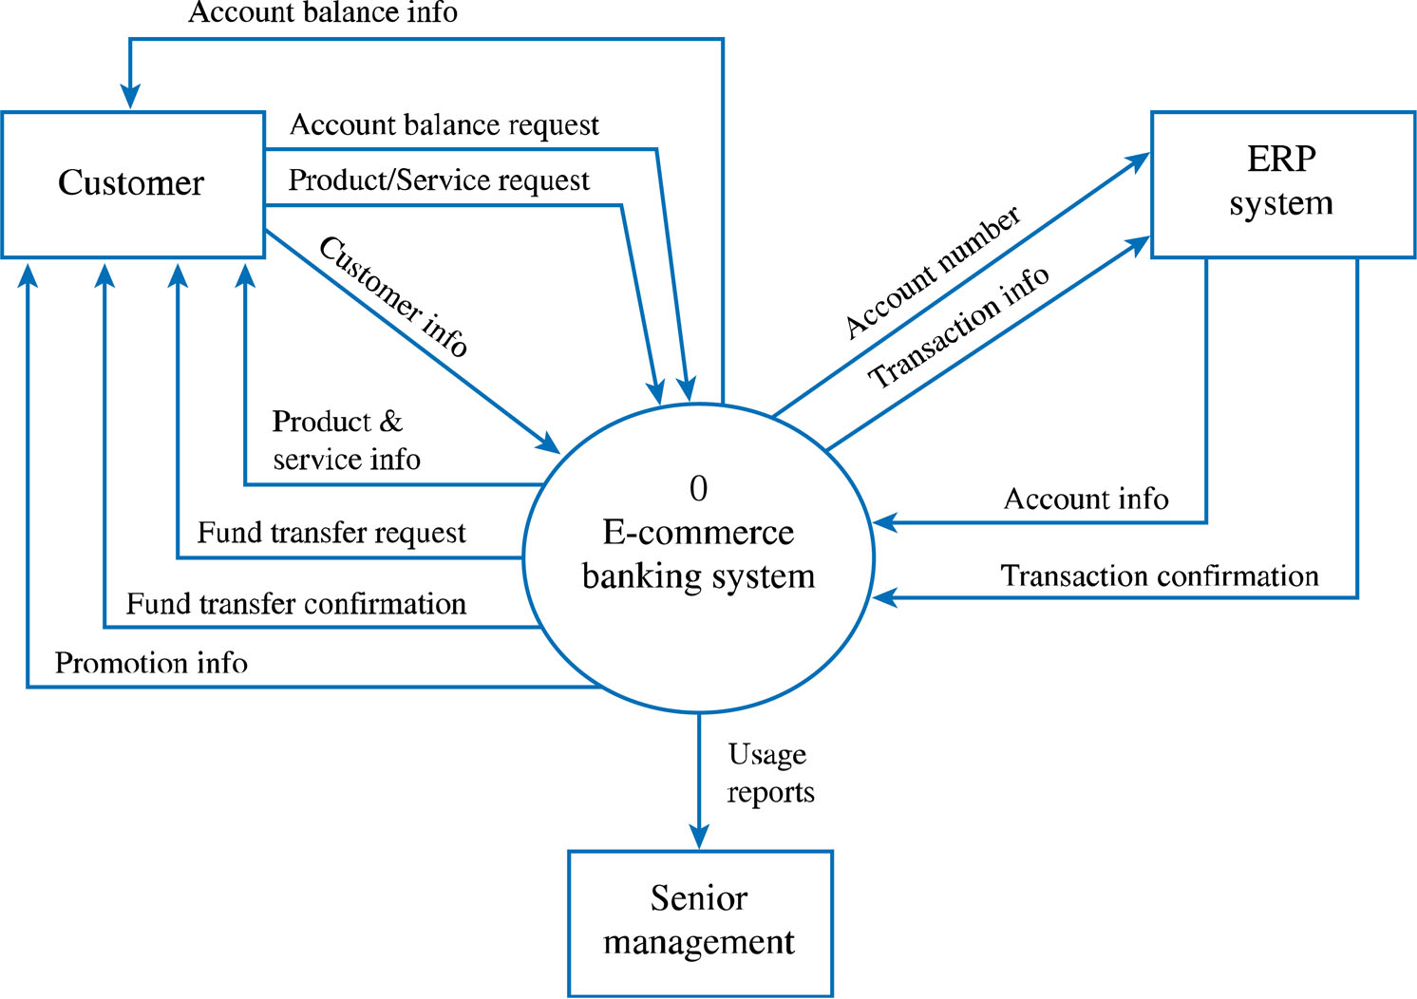
Context Level Data Flow Diagram

Slide 14
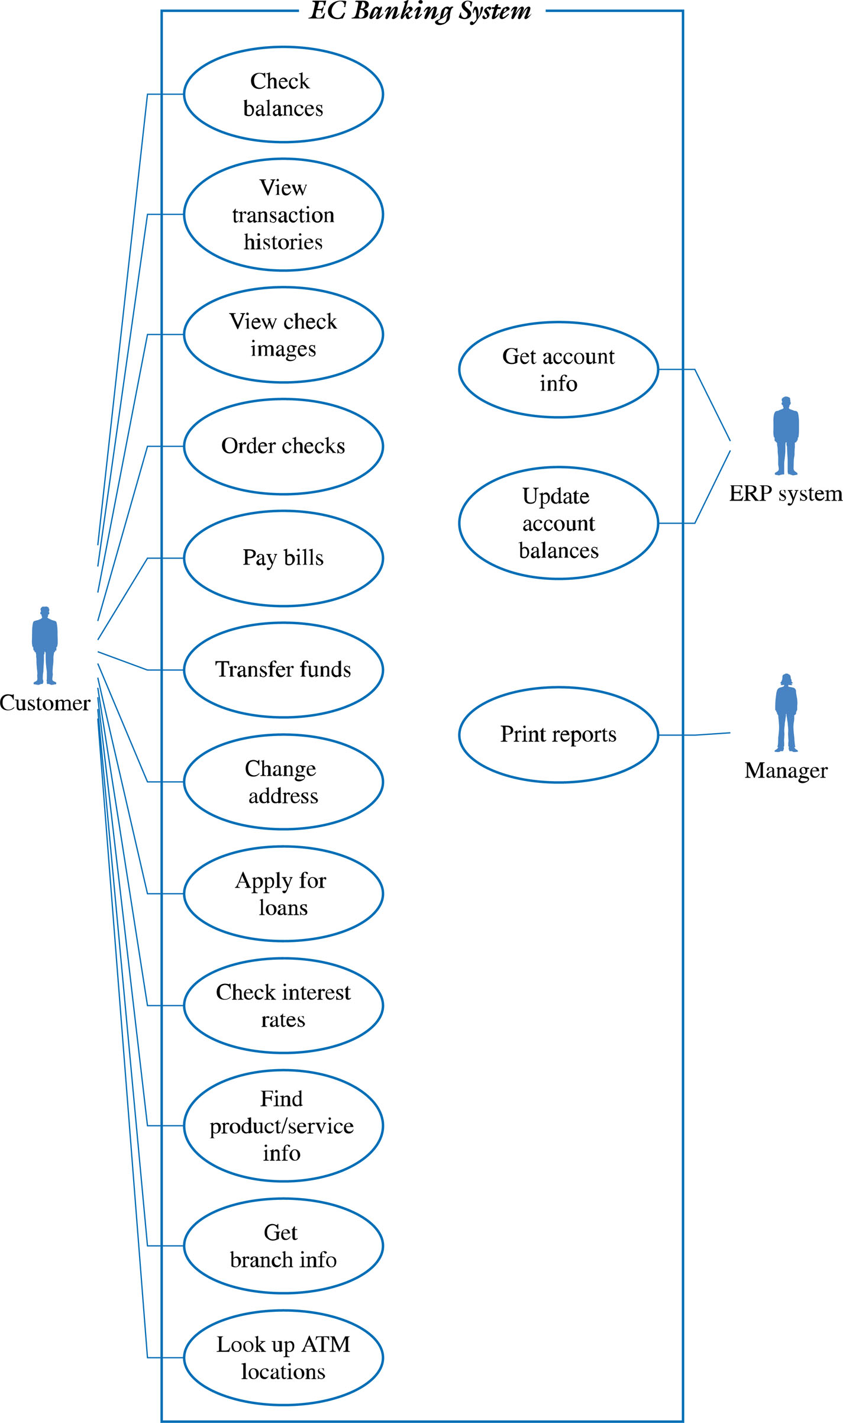
Use Case Diagram

Slide 15
Scope Verification
Ensures:
  That the project’s scope is well-defined, accurate and complete
  The project’s scope is acceptable to the project stakeholders
  That standards exist so that the project’s scope will be completed correctly
  That the project’s MOV will be achieved if the project scope is completed
Tools
  Scope Verification Checklist

Slide 16
Scope Verification Check List
MOV – Has the project’s MOV been clearly defined and agreed upon? Failure to define and agree upon the MOV will result in scope changes later on in the project. This can lead to added work that can impact the project’s schedule and budget.
Deliverables – Are the deliverables tangible and verifiable? Do they support the project’s MOV?
Quality Standards - Are controls in place to ensure that the work was not only completed but also completed to meet specific standards?
Milestones – Are significant events that mark the acceptance of a deliverable and give the project manager and team the approval to begin working on the next deliverable. Milestones tell us that a deliverable was not only completed, but that it was also reviewed and accepted.
Review and Acceptance – Finally, the project’s scope must be reviewed and accepted by the project stakeholders. The project sponsor must formally accept the boundary, product to be produced and the project-related deliverables. On the other hand, the project team must accept and be clear as to what it must deliver.

Slide 17
Scope Change Control
Ensures that any changes to the project’s scope will help the project achieve its MOV.
Keeps the “triple constraint” in balance.
  i.e., an increase in scope will require an increase in the project’s schedule (Time) and budget (cost).
Scope
Time
Cost

Slide 18
Scope Change Control
Mitigates:
  Scope Grope – i.e., scope poorly defined
  Scope Creep – i.e., increasing featurism (features)
  Scope Leap – i.e., drastic change in project direction or the project’s MOV
Tools used:
  Scope Change Request Form
  Scope Change Request Log

Slide 19
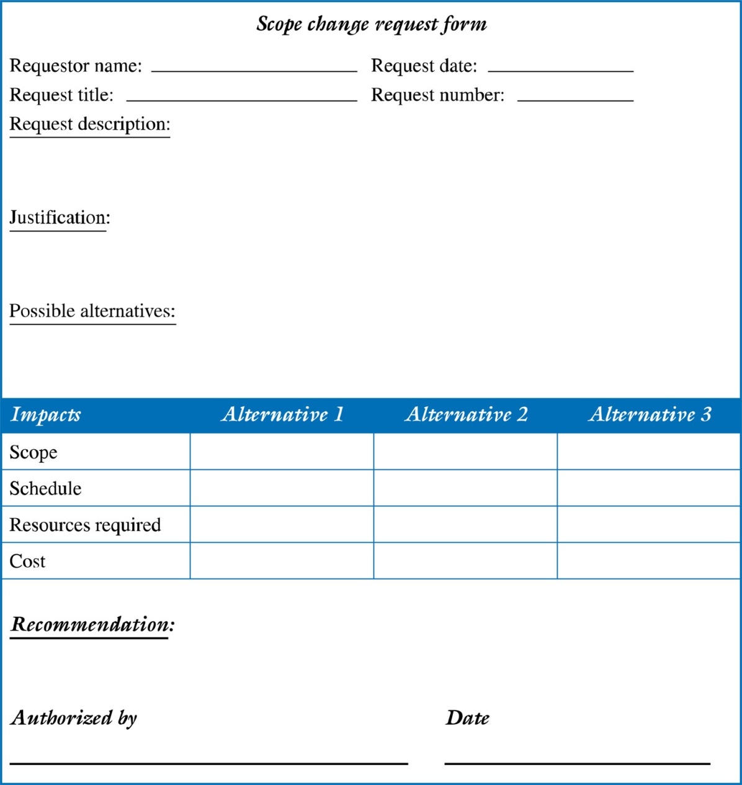
Example of a Scope Change Request Form

Slide 20
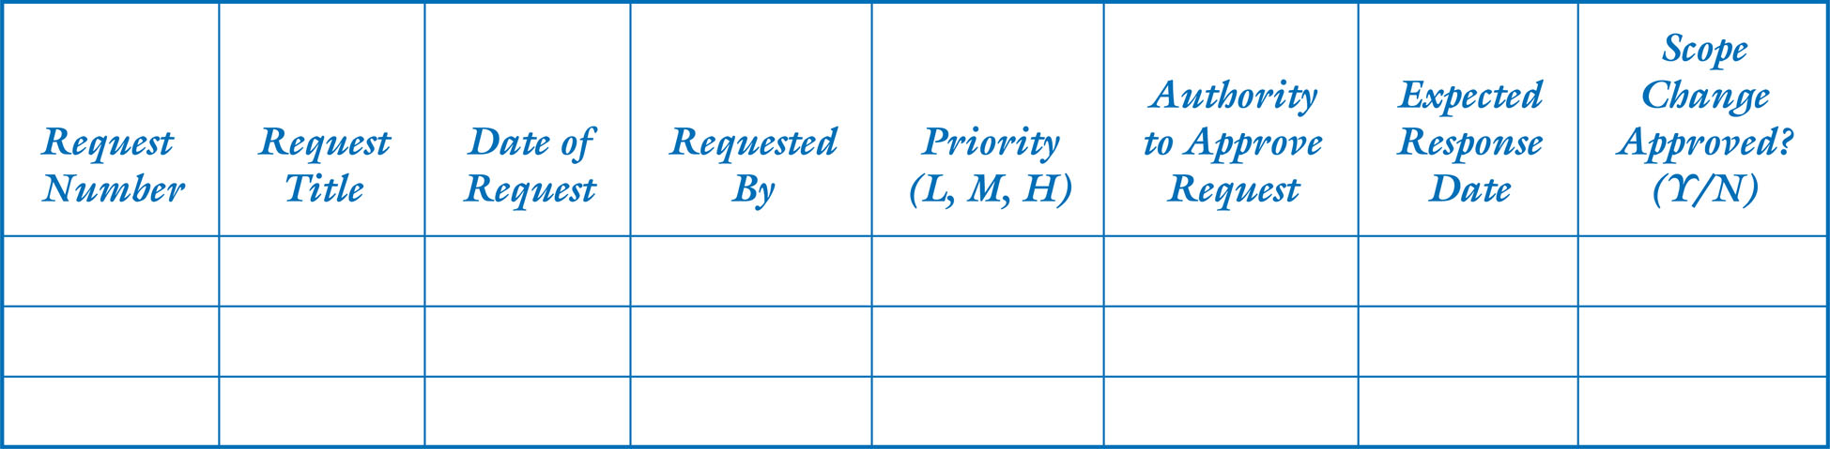
Example of a Scope Change Request Log

Slide 21
Benefits of Scope Control
Keeps the project manager in control of the project.
  Gives the project manager the authority to manage and control the project’s schedule and budget. Otherwise she or he may ‘feel” pressured by the client or upper management to accept scope changes
Allows the project team to stay focused and on track
  Do not have to perform unnecessary work

Slide 22
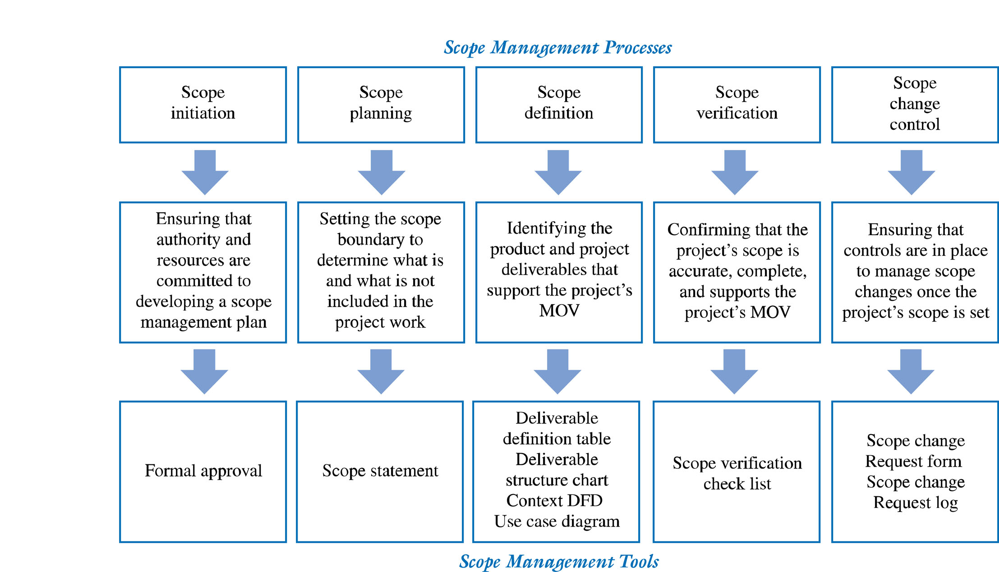
Summary of Scope Management Processes

